Slide 1
Beautiful Soup 사용하기

Slide 2
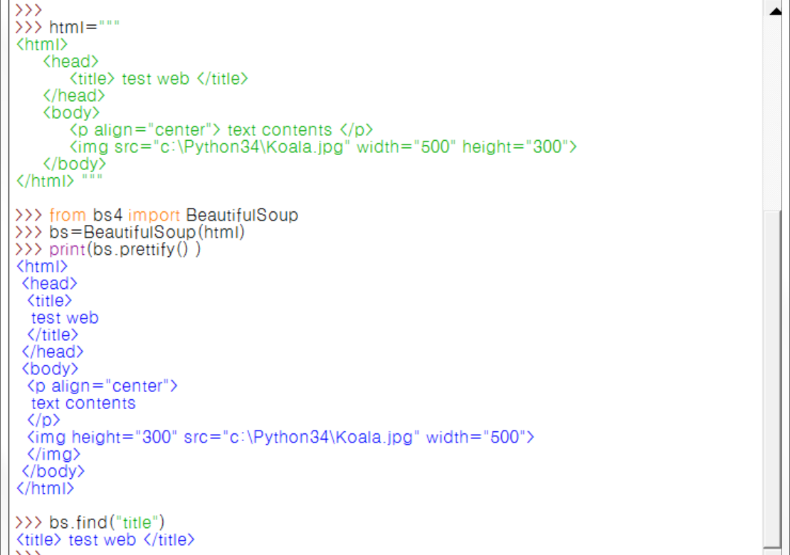
Import Beautiful Soup
Notes:
html="""
<html>
<head>
<title> test web</title>
</head>
<body>
<p align="center"> text contents1</p>
<p align="right"> text contents2</p>
<p align="left"> text contents3</p>
<img src="C:python36\Koala.jpg" width="500" height="300">
</body>
</html>"""
>>> from bs4 import BeautifulSoup
>>> bs=BeautifulSoup(html)

Slide 3
Html 코드 가운데 수정하기

Slide 5
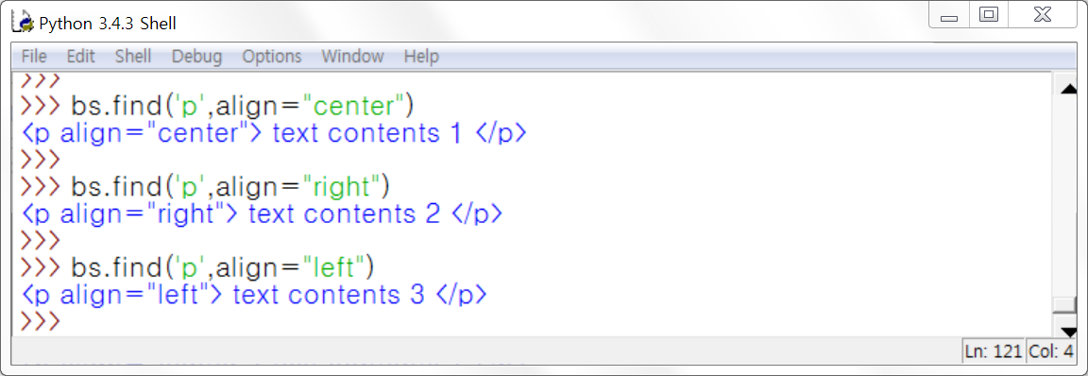
Bs.find() –태그를 하나만 가져옴
Notes:
>>> bs=BeautifulSoup(html)
>>> bs.find('p', align="center")
<p align="center"> text contents1</p>
>>> bs.find('p', align="right")
<p align="right"> text contents2</p>
>>> bs.find('p', align="left")
<p align="left"> text contents3</p>

Slide 6
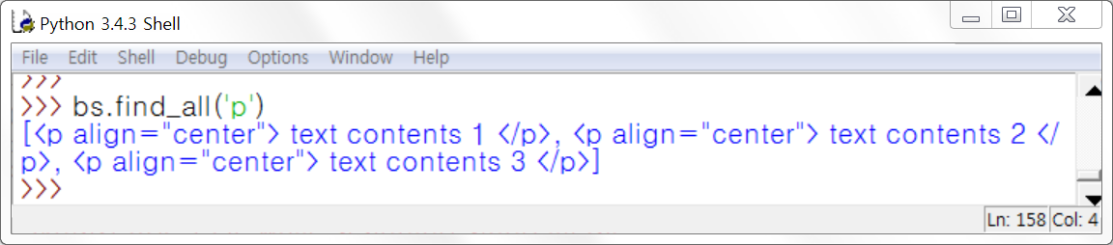
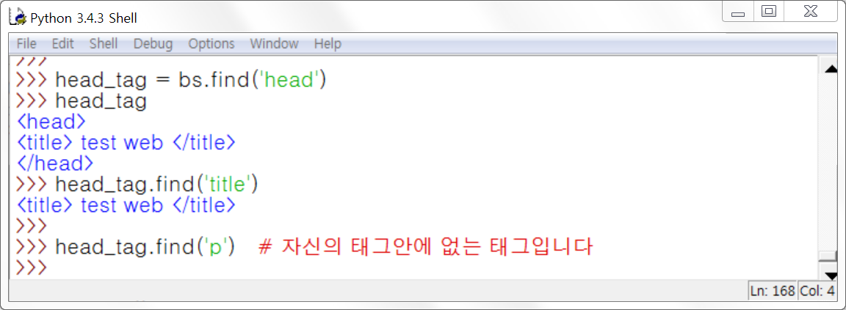
Find_all()
Notes:
>>> html="""
<html>
<head>
<title> test web</title>
</head>
<body>
<p align="center"> text contents1</p>
<p align="right"> text contents2</p>
<p align="left"> text contents3</p>
<img src="C:python36\Koala.jpg" width="500" height="300">
</body>
</html>"""
>>> bs=BeautifulSoup(html)
>>> bs.find_all('p')
[<p align="center"> text contents1</p>, <p align="right"> text contents2</p>, <p align="left"> text contents3</p>]
>>> head_tag=bs.find('head')
>>> head_tag
<head>
<title> test web</title>
</head>
>>> head_tag.find('title')
<title> test web</title>
>>> head_tag.find('p') # 자신의 태그안에 없는 태그입니다.

Slide 7
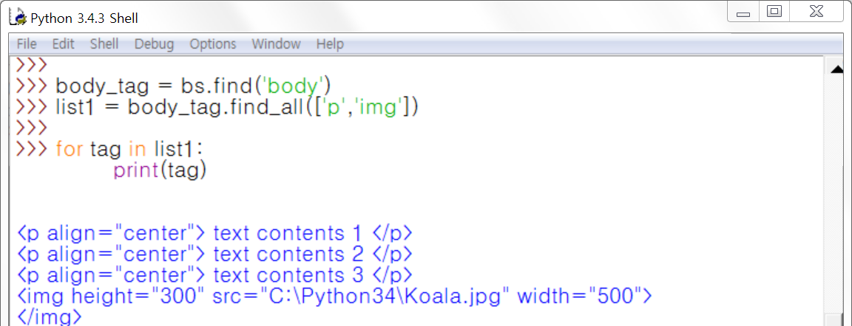
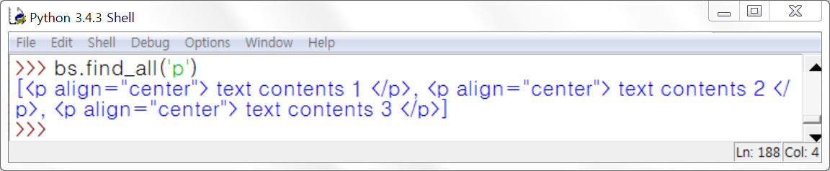
2)find_all-문자열 사용
Notes:
>>> body_tag=bs.find('body')
>>> list1=body_tag.find_all(['p','img'])
>>>
>>> for tag in list1:
print(tag)
<p align="center"> text contents1</p>
<p align="right"> text contents2</p>
<p align="left"> text contents3</p>
<img height="300" src="C:python36\Koala.jpg" width="500"/>
>>> bs.find_all('p')
[<p align="center"> text contents1</p>, <p align="right"> text contents2</p>, <p align="left"> text contents3</p>]

Slide 8
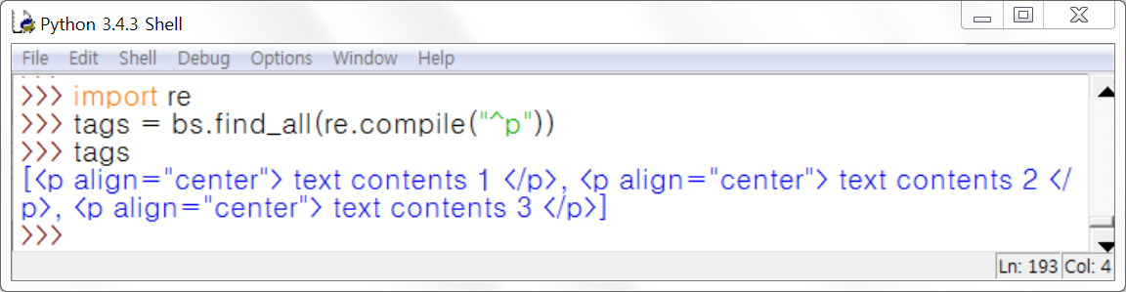
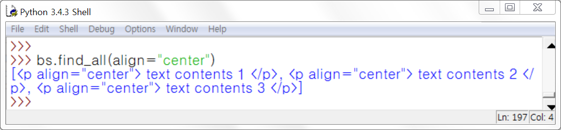
find_all()함수 – 정규식 사용
Notes:
import re
>>> tags=bs.find_all(re.compile("^p"))
>>> tags
[<p align="center"> text contents1</p>, <p align="right"> text contents2</p>, <p align="left"> text contents3</p>]
bs.find_all(align="center")
[<p align="center"> text contents1</p>]

Slide 9
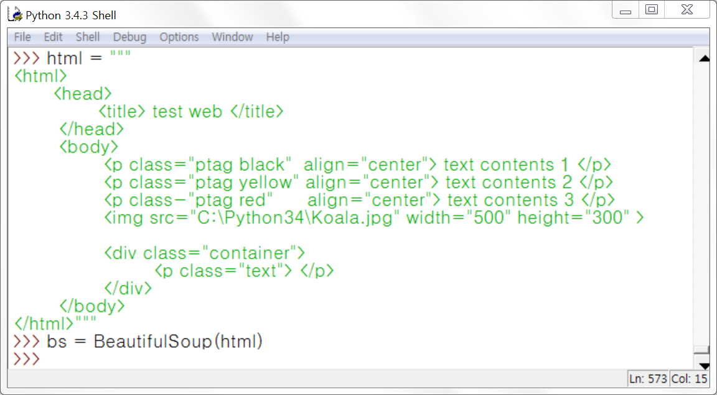
find_parent() 함수와 find_parents() 함수
Notes:
html="""
<html>
<head>
<title> test web</title>
</head>
<body>
<p class="ptag black" align="center"> text contents1</p>
<p class="ptag yellow" align="center"> text contents2</p>
<p class="ptag red" align="center"> text contents3</p>
<img src="C:python36\Koala.jpg" width="500" height="300">
<div class="container">
<p class="text"></p>
</div>
</body>
</html>"""

Slide 10
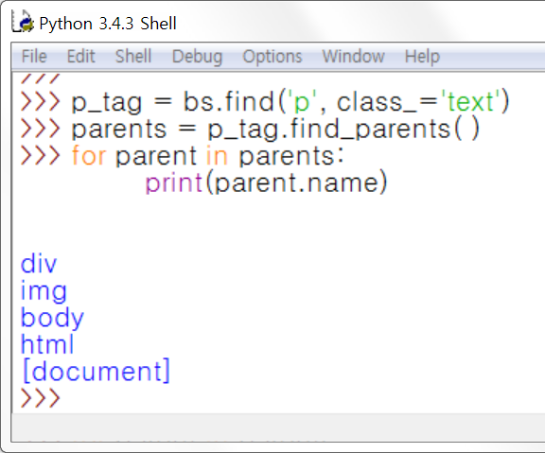
find_parent() 함수와 find_parents() 함수
Notes:
p_tag=bs.find('p', class_='text')
>>> parents=p_tag.find_parents()
>>> for parent in parents:
print(parent.name)

Slide 11
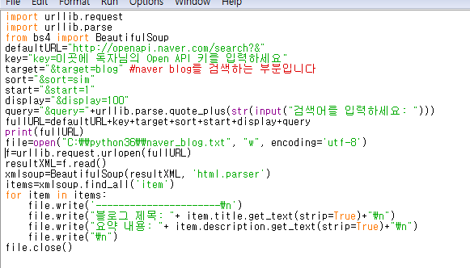
잘못된 URL
Notes:
import urllib.request
import urllib.parse
from bs4 import BeautifulSoup
defaultURL="http://openapi.naver.com/search?&"
key="key=이곳에 독자님의 Open API 키를 입력하세요"
target="&target=blog" #naver blog를 검색하는 부분입니다
sort="&sort=sim"
start="&start=1"
display="&display=100"
query="&query="+urllib.parse.quote_plus(str(input("검색어를 입력하세요: ")))
fullURL=defaultURL+key+target+sort+start+display+query
print(fullURL)
file=open("C:\\python36\\naver_blog.txt", "w", encoding='utf-8')
f=urllib.request.urlopen(fullURL)
resultXML=f.read()
xmlsoup=BeautifulSoup(resultXML, 'html.parser')
items=xmlsoup.find_all('item')
for item in items:
file.write('----------------------\n')
file.write("블로그 제목: "+ item.title.get_text(strip=True)+"\n")
file.write("요약 내용: "+ item.description.get_text(strip=True)+"\n")
file.write("\n")
file.close()

Slide 12
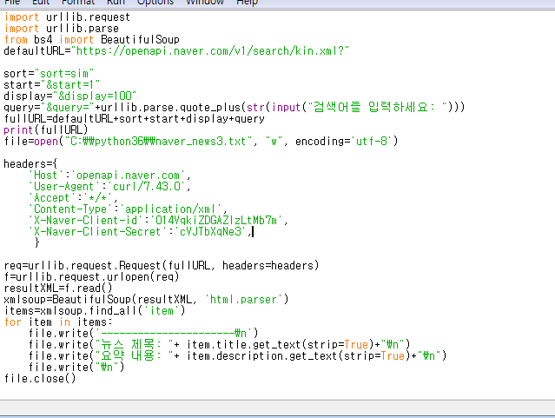
평창 URL
Notes:
import urllib.request
import urllib.parse
from bs4 import BeautifulSoup
defaultURL="https://openapi.naver.com/v1/search/kin.xml?"
sort="sort=sim"
start="&start=1"
display="&display=100"
query="&query="+urllib.parse.quote_plus(str(input("검색어를 입력하세요: ")))
fullURL=defaultURL+sort+start+display+query
print(fullURL)
file=open("C:\\python36\\naver_news3.txt", "w", encoding='utf-8')
headers={
'Host':'openapi.naver.com',
'User-Agent':'curl/7.43.0',
'Accept':'*/*',
'Content-Type':'application/xml',
'X-Naver-Client-id':'014VqkiZDGAZIzLtMb7m',
'X-Naver-Client-Secret':'cVJTbXqNe3',
}
req=urllib.request.Request(fullURL, headers=headers)
f=urllib.request.urlopen(req)
resultXML=f.read()
xmlsoup=BeautifulSoup(resultXML, 'html.parser')
items=xmlsoup.find_all('item')
for item in items:
file.write('----------------------\n')
file.write("뉴스 제목: "+ item.title.get_text(strip=True)+"\n")
file.write("요약 내용: "+ item.description.get_text(strip=True)+"\n")
file.write("\n")
file.close()

Slide 13
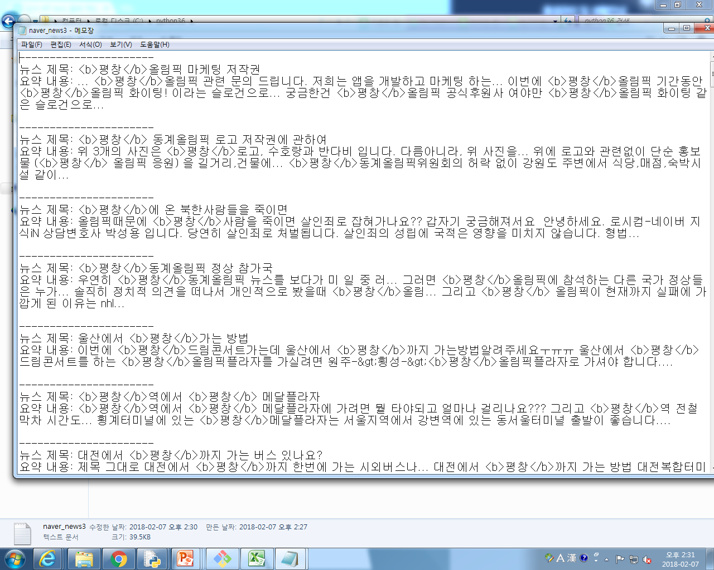

Slide 14
p319
Notes:
import urllib.request
import urllib.parse
import re
def input_query():
q=urllib.parse.quote_plus(str(input("검색어를 입력하세요: ")))
return "&query="+q
def bind_url():
default_url="http://openapi.naver.com/search?target=image&display=100&"
API_Key="key=9c8c4c4c3325fc08268afc10e4fc2245"
query=input_query()
start="&start="+str(1)
sort="sort="+"sim"
full_url=default_url+API_Key+query+start+sort
return full_url
def fetch_contents_from_url():
url=bind_url()
r=urllib.request.urlopen(url)
html=r.read()
return html
def extract_text_in_tags(tags,tagname="title"):
txt=[]
reg="[^<]"+ tagname+ ">][^<]+"
for tag in tags:
txt.append(re.search(reg,tag).group() )
return txt
def get_contents_from_html():
html=fetch_contents_from_url()
title_tags=re.findall("<title>[^<]+</title>",html.decode('utf-8'))
link_tags=re.findall("<link>[^<]+</link>",html.decode('utf-8'))
titles=extract_text_in_tags(title_tags,tagname='title')
links=extract_text_in_tags(title_tags,tagname='link')
f=open("image.html","w")
f.write("<html><body>")
for i in range(1,len(titles)):
f.write("<p>"+titles[i]+"</p>")
f.write("<img src="+links[i]+"/>")
f.write("</body></html>")
f.close()
get_contents_from_html()

Slide 15
import urllib.request
import urllib.parse
import re
def input_query():
q=urllib.parse.quote_plus(str(input("검색어를 입력하세요: ")))
return "&query="+q
def bind_url():
default_url="https://openapi.naver.com/v1/search/image.xml"
API_Key="key=9c8c4c4c3325fc08268afc10e4fc2245"
query=input_query()
start="&start="+str(1)
sort="sort="+"sim"
full_url=default_url+API_Key+query+start+sort
return full_url
def fetch_contents_from_url():
url=bind_url()
r=urllib.request.urlopen(url)
html=r.read()
return html
def extract_text_in_tags(tags,tagname="title"):
txt=[]
reg="[^<]"+ tagname+ ">][^<]+"
for tag in tags:
txt.append(re.search(reg,tag).group() )
return txt
def get_contents_from_html():
html=fetch_contents_from_url()
title_tags=re.findall("<title>[^<]+</title>",html.decode('utf-8'))
link_tags=re.findall("<link>[^<]+</link>",html.decode('utf-8'))
titles=extract_text_in_tags(title_tags,tagname='title')
links=extract_text_in_tags(title_tags,tagname='link')
f=open("image.html","w")
f.write("<html><body>")
for i in range(1,len(titles)):
f.write("<p>"+titles[i]+"</p>")
f.write("<img src="+links[i]+"/>")
f.write("</body></html>")
f.close()
get_contents_from_html()
from bs4 import BeautifulSoup
defaultURL="https://openapi.naver.com/v1/search/kin.xml?"
sort="sort=sim"
start="&start=1"
display="&display=100"
query="&query="+urllib.parse.quote_plus(str(input("검색어를 입력하세요: ")))
fullURL=defaultURL+sort+start+display+query
print(fullURL)
file=open("C:\\python36\\naver_news3.txt", "w", encoding='utf-8')
headers={
'Host':'openapi.naver.com',
'User-Agent':'curl/7.43.0',
'Accept':'*/*',
'Content-Type':'application/xml',
'X-Naver-Client-id':'014VqkiZDGAZIzLtMb7m',
'X-Naver-Client-Secret':'cVJTbXqNe3',
}
req=urllib.request.Request(fullURL, headers=headers)
f=urllib.request.urlopen(req)
resultXML=f.read()
xmlsoup=BeautifulSoup(resultXML, 'html.parser')
items=xmlsoup.find_all('item')
for item in items:
file.write('----------------------\n')
file.write("뉴스 제목: "+ item.title.get_text(strip=True)+"\n")
file.write("요약 내용: "+ item.description.get_text(strip=True)+"\n")
file.write("\n")
file.close()

Slide 17
P319 이미지 크롤링
Notes:
import urllib.request
import urllib.parse
import re
def bind_url():
default_url="https://openapi.naver.com/v1/search/image.xml"
start="&start=1"
sort="&sort=sim"
display="&display=10"
query="&query="+urllib.parse.quote_plus(str(input("검색어를 입력하세요: ")))
full_url=default_url+sort+start+display+query
print(full_url)
return full_url
def fetch_contents_from_url():
url=bind_url()
headers={
'Host':'openapi.naver.com',
'User-Agent':'curl/7.43.0',
'Accept':'*/*',
'Content-Type':'application/xml',
'X-Naver-Client-id':'014VqkiZDGAZIzLtMb7m',
'X-Naver-Client-Secret':'cVJTbXqNe3',
}
r=urllib.request.urlopen(url)
m=urllib.request.urlopen(r)
html=r.read()
return html
def extract_text_in_tags(tags,tagname="title"):
txt=[]
reg="[^<]"+ tagname+ ">][^<]+"
for tag in tags:
txt.append(re.search(reg,tag).group() )
return txt
def get_contents_from_html():
html=fetch_contents_from_url()
title_tags=re.findall("<title>[^<]+</title>",html.decode('utf-8'))
link_tags=re.findall("<link>[^<]+</link>",html.decode('utf-8'))
titles=extract_text_in_tags(title_tags,tagname='title')
links=extract_text_in_tags(title_tags,tagname='link')
f=open("image.html","w")
f.write("<html><body>")
for i in range(1,len(titles)):
f.write("<p>"+titles[i]+"</p>")
f.write("<img src="+links[i]+"/>")
f.write("</body></html>")
f.close()
get_contents_from_html()

Slide 18
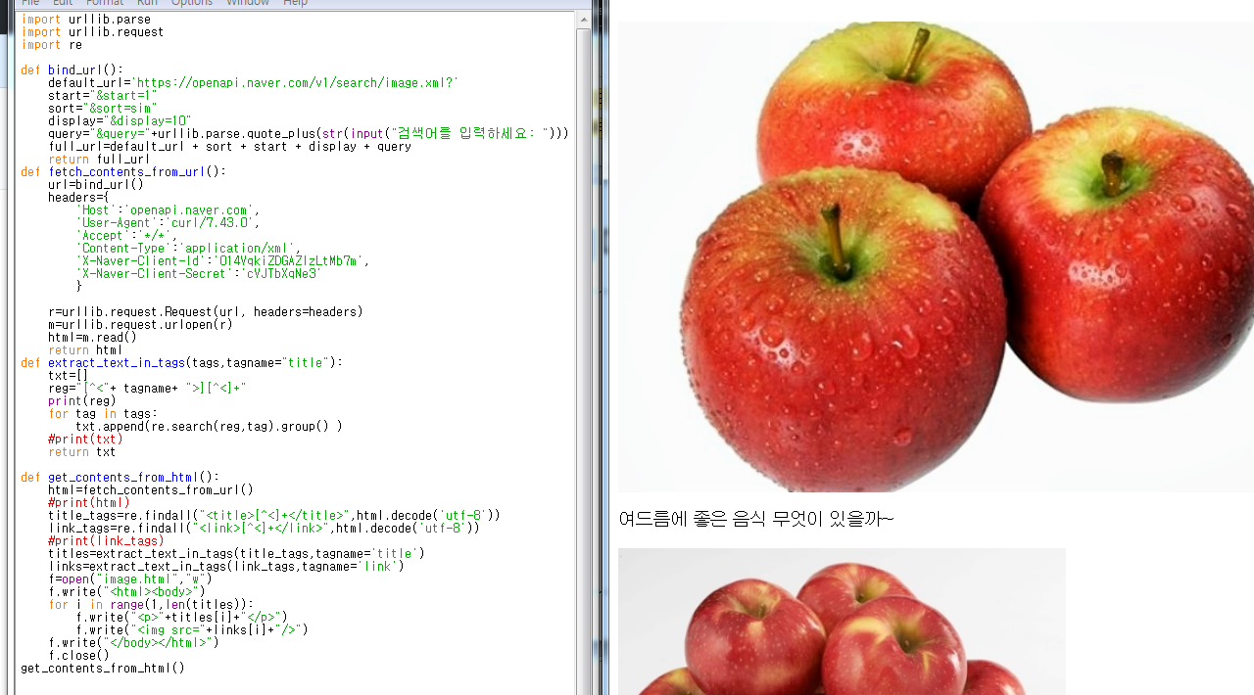
이미지 크롤링
Notes:
import urllib.parse
import urllib.request
import re
def bind_url():
default_url='https://openapi.naver.com/v1/search/image.xml?'
start="&start=1"
sort="&sort=sim"
display="&display=10"
query="&query="+urllib.parse.quote_plus(str(input("검색어를 입력하세요: ")))
full_url=default_url + sort + start + display + query
return full_url
def fetch_contents_from_url():
url=bind_url()
headers={
'Host':'openapi.naver.com',
'User-Agent':'curl/7.43.0',
'Accept':'*/*',
'Content-Type':'application/xml',
'X-Naver-Client-Id':'014VqkiZDGAZIzLtMb7m',
'X-Naver-Client-Secret':'cVJTbXqNe3'
}
r=urllib.request.Request(url, headers=headers)
m=urllib.request.urlopen(r)
html=m.read()
return html
def extract_text_in_tags(tags,tagname="title"):
txt=[]
reg="[^<"+ tagname+ ">][^<]+"
print(reg)
for tag in tags:
txt.append(re.search(reg,tag).group() )
#print(txt)
return txt
def get_contents_from_html():
html=fetch_contents_from_url()
#print(html)
title_tags=re.findall("<title>[^<]+</title>",html.decode('utf-8'))
link_tags=re.findall("<link>[^<]+</link>",html.decode('utf-8'))
#print(link_tags)
titles=extract_text_in_tags(title_tags,tagname='title')
links=extract_text_in_tags(link_tags,tagname='link')
f=open("image.html","w")
f.write("<html><body>")
for i in range(1,len(titles)):
f.write("<p>"+titles[i]+"</p>")
f.write("<img src="+links[i]+"/>")
f.write("</body></html>")
f.close()
get_contents_from_html()

